Slide 1
Sect. 7.1 Introduction to Exponential and Logarithmic Functions
© Copyright all rights reserved to Homework depot: www.BCMath.ca

Slide 2
Exponential Functions and Logarithms
This section will focus on two things:
Outcome #1: Understanding what a exponential function is
  How the graph looks (Curved Function)
  Increasing [appreciation] / Decreasing [depreciation]
Outcome #2: Using Logarithms to find the value of an exponent when given a power
  The purpose of a logarithm is to find the exponent

Slide 3
I) What are Exponential Functions?
An exponential function increases or decreases by a fixed ratio as the horizontal axis increases by increments of one unit
Anything that has to do with “Appreciation” [increase in value ] or “Depreciation” [decrease in value]has to do with exponential functions
Ie: a fixed income that generates 10% return annually, increases by 10% each year, starting with $100 [appreciation]
Ie: the value of a Mercedes-Benz loses 10% of it’s value each year [Depreciation]
“A” – Initial Amount, Value at the beginning
“B” – Rate of Change, Appreciate rate or Depreciation rate
The value of “B” is always bigger than zero, can not be negative
B > 1 → Value increases, growth
0<B < 1 → Value decreases, decline

Slide 4
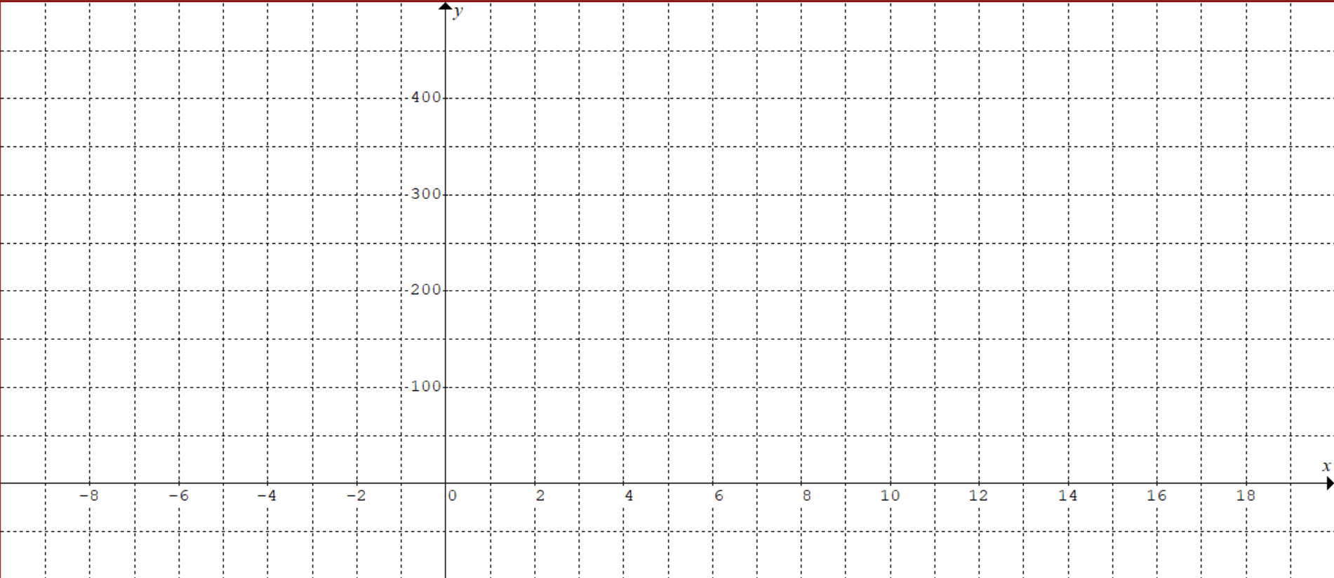
How Exponential Functions Look:
An exponential function increases or decreases by a fixed ratio as the horizontal axis increases by increments of one unit
Ie: a fixed income that generates 10% return annually, increases by 10% each year, starting with $100

Slide 5
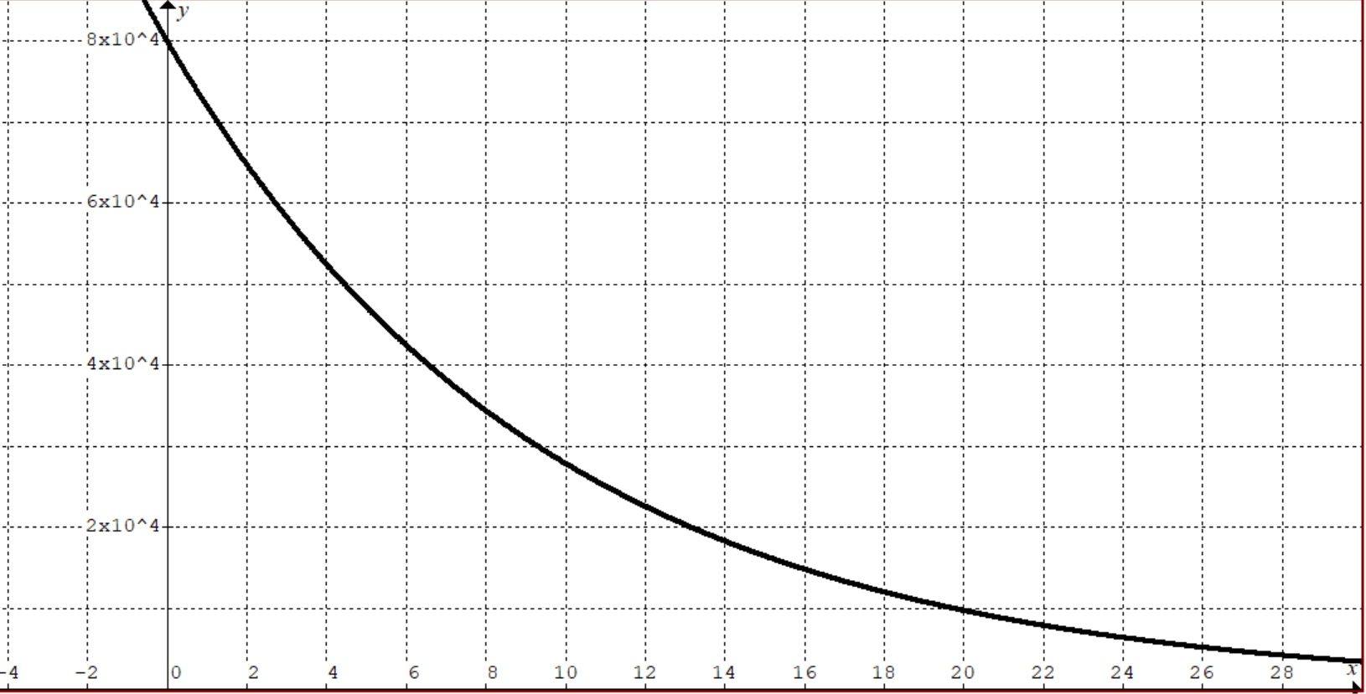
Depreciation
A Mercedes Benz was purchased at $80,000 and depreciates by 10% each year. How much is it worth after 5 years?
y
0
1
2
3
4
© Copyright all rights reserved to Homework depot: www.BCMath.ca

Slide 6
II) Putting It together:
Rather than multiplying by the same constant repeatedly, we can use an exponential function
Increase by 10%
Number of
Years
Initial
Amount
“x” number of years
Rate of
Growth
Decrease by 10%
“x” number of years
General
Formula:
Number of
Years
Final
Amount
Initial
Amount
Rate of
Growth
© Copyright all rights reserved to Homework depot: www.BCMath.ca

Slide 7
Characteristics of an Exponential Function:
Exponential functions are NOT Linear, but curves up/down depending on the value of “B”
y
y
x
x
Domain:
Range:
Range:

Slide 8
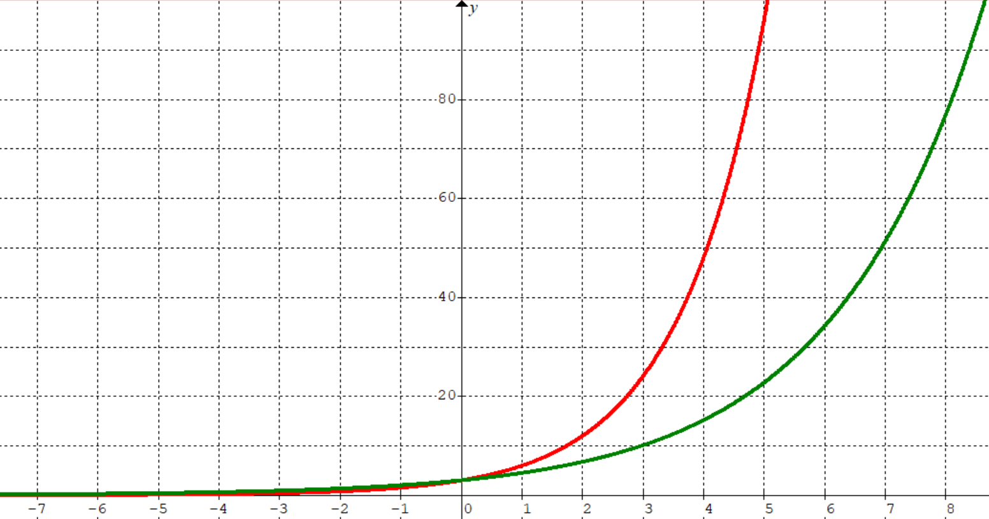
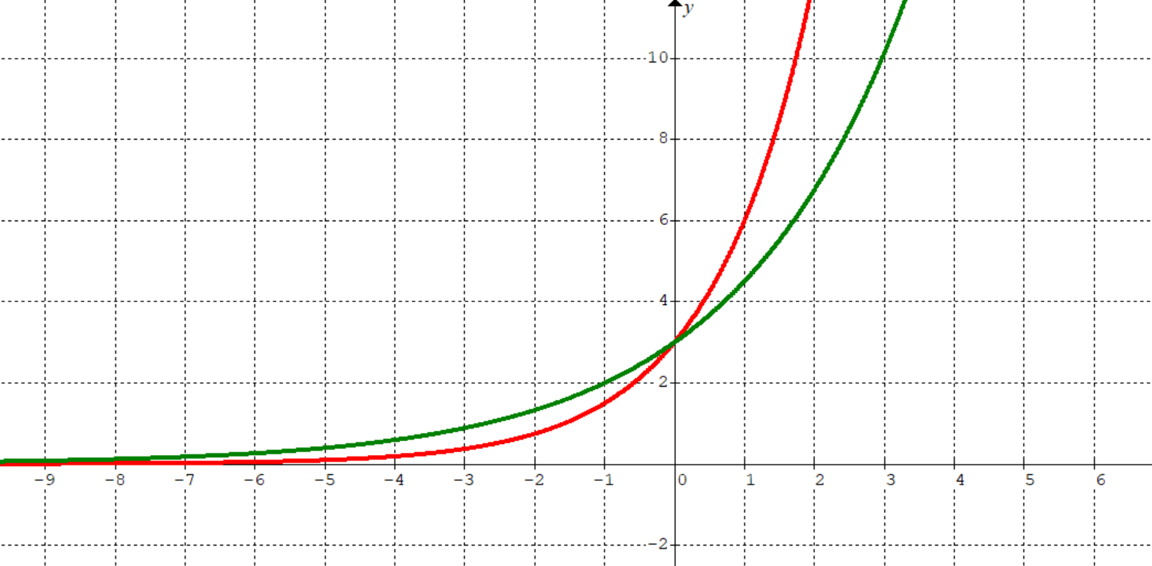
Exponential Function when “$B>1$” [Increasing Function]
y
With a larger base “B”, it will start off slower before the “Y-intercept”. Then once it crosses the Y-axis, it will increase a lot faster!
12
11
10
9
8
7
6
5
4
3
2
1
x
-5
-4
-3
-2
-1
0
1
2
-1
© Copyright all rights reserved to Homework depot: www.BCMath.ca

Slide 9
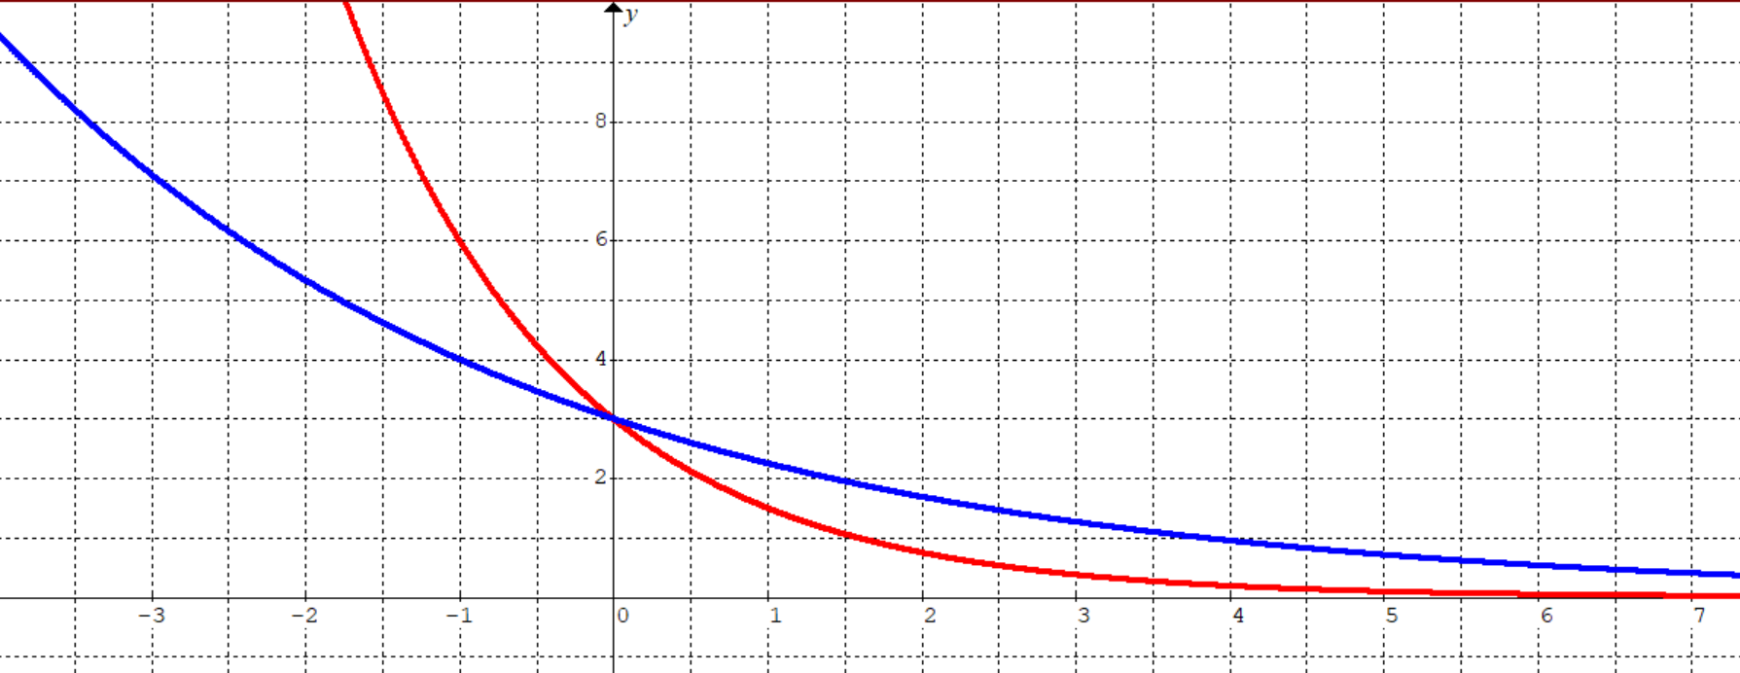
Exponential Function when “$0<B<1$” [Decreasing Function]
y
IF “B” is closer to zero
[smaller], the graph will
decrease slower before the “Y” intercept. But when it’s past the Y-axis, the graph will decrease a lot faster!!
12
11
10
9
8
7
6
5
Keep in mind that both graphs do not touch the X-axis!
4
3
2
1
x
5
4
3
2
1
0
-1
-2
-1
© Copyright all rights reserved to Homework depot: www.BCMath.ca

Slide 10
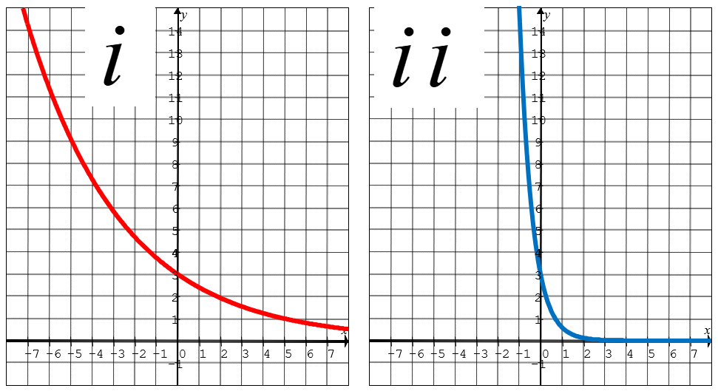
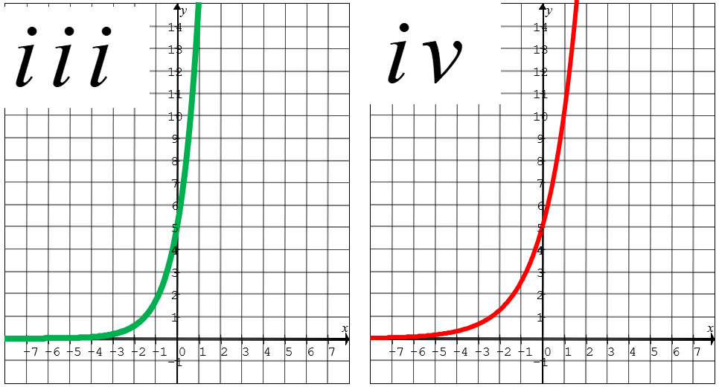
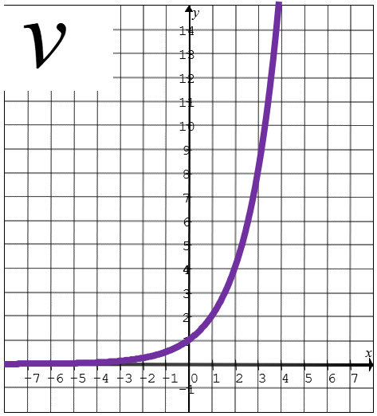
Ex: Given the equations, indicate which of the following is the correct graph
© Copyright all rights reserved to Homework depot: www.BCMath.ca

Slide 11
Using Logarithms to Find Exponents:
In this section, we will only discuss how to find exponents using logarithms, “Log” properties will be taught in a later lesson
When given an equation in the form and asked to solve for the exponent:
First isolate the power
Next, take the log of the number on the left and divide it by the log of the base. This will be equal to the exponent

Slide 12
Ex: The population in Canada is increasing at an annual rate of 3.5%. If the current population is 40 million, when will the population reach 100 million people?
The population of Canada will
reach 100 million approximately
26.64 years
© Copyright all rights reserved to Homework depot: www.BCMath.ca

Slide 13
Ex: Suppose you deposit $10,000 in a bank with a Mutual Fund that gives an annual return of 8%.
a) Write an equation to show how much money you have after “x” number of years.
b) Is this an increasing or decreasing function? How do you know?
c) How much money will you have after 5 years?
d) How many years will it take for your money to double in value?
e) How many years will it take for your money to triple in value?

Slide 14
Compound Interest
A bank pays 8% interest compounded once a year. How much money will you make in 15 years if you deposited $10,000?
1
2
3
4
5
6
7
8
9
10
11
12
13
14
15
© Copyright all rights reserved to Homework depot: www.BCMath.ca

